Slide 1
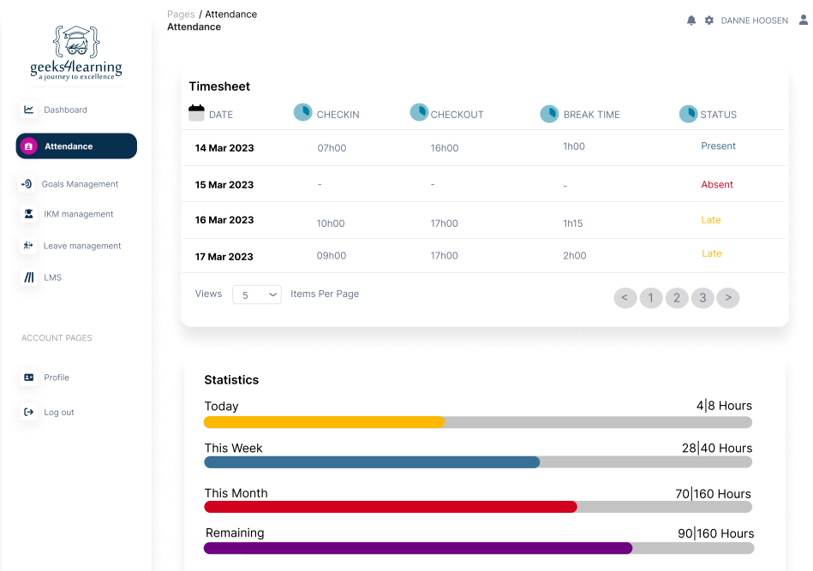
Attendance Management System
An Innovative Approach to Attendance Tracking

Slide 2
Problem Statement.
Attendance: Tracked through the use of ERS Biometrics System.
Technical Issues: Biometric systems may experience technical glitches, leading to inaccuracies in attendance records.
Tailgating Concerns: This poses a risk of stealing working hours and facilitating extended lunch breaks.

Slide 3
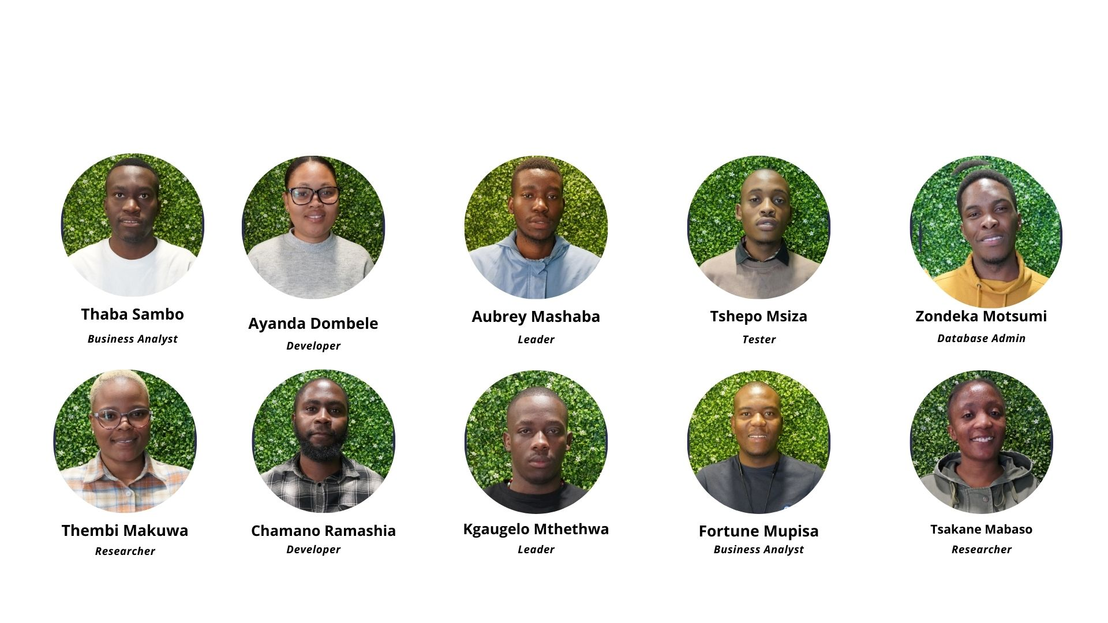
Our Team.

Slide 4
Our Solution.
Enhancing attendance tracking
Integrate with the existing ERS Biometrics System to provide a seamless attendance tracking process.
Ensures compliance with attendance policies.

Slide 5

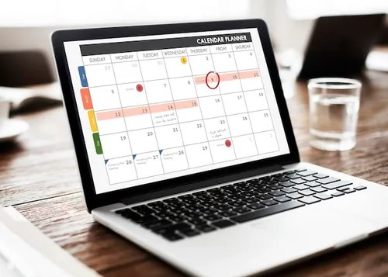
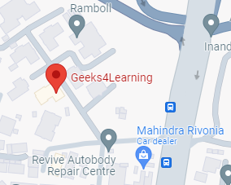

Our System.
Explore system key features.
Streamlines Attendance Tracking
Login Location Check
Automatic Leave Update

Slide 6




Technologies Used.
Tech Stack Overview
Frontend development
Database Management
Backend development
API Testing

Slide 7

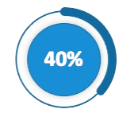
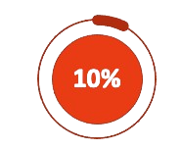
System Progress.
System Progress Overview.
System Documentation
Backend Development
Frontend Development

Slide 8

Q & A
Questions and Answers Session: Your Participation is Welcome.

